Slide 1
Redis Admin Guide Version 6.x
Subramanian Murugan

Slide 2
Server Information
The INFO command returns information and statistics about the server in a format that is simple to parse by computers and easy to read by humans

Slide 3
Server Information
server: General information about the Redis server
clients: Client connections section
memory: Memory consumption related information
persistence: RDB and AOF related information
stats: General statistics
cpu: CPU consumption statistics
replication: Master/replica replication information
commandstats: Redis command statistics
cluster: Redis Cluster section
modules: Modules section
keyspace: Database related statistics
modules: Module related sections

Slide 4
127.0.0.1:6379> info server
# Server
redis_version:6.0.4
redis_git_sha1:00000000
redis_git_dirty:0
redis_build_id:d5d470262d47f1a0
redis_mode:standalone
os:Linux 5.4.39-linuxkit x86_64
arch_bits:64
multiplexing_api:epoll
atomicvar_api:atomic-builtin
gcc_version:8.3.0
process_id:1
run_id:61f5655ab040172ca1db1ffa194874f6b91c3f70
tcp_port:6379
uptime_in_seconds:50006
uptime_in_days:0
hz:10
configured_hz:10
lru_clock:12991880
executable:/data/redis-server
config_file:

Slide 5
Client Information-Redis Client Handling
How client connections are accepted
Redis accepts clients connections on the configured listening TCP port and on the Unix socket if enabled.
Client connection work flow
The client socket is put in non-blocking state since Redis uses multiplexing and non-blocking I/O.
The TCP_NODELAY option is set in order to ensure that we don't have delays in our connection
A readable file event is created so that Redis is able to collect the client queries as soon as new data is available to be read on the socket.
After the client is initialized, Redis checks if we are already at the limit of the number of clients that it is possible to handle simultaneously (this is configured using the maxclients configuration directive).

Slide 6
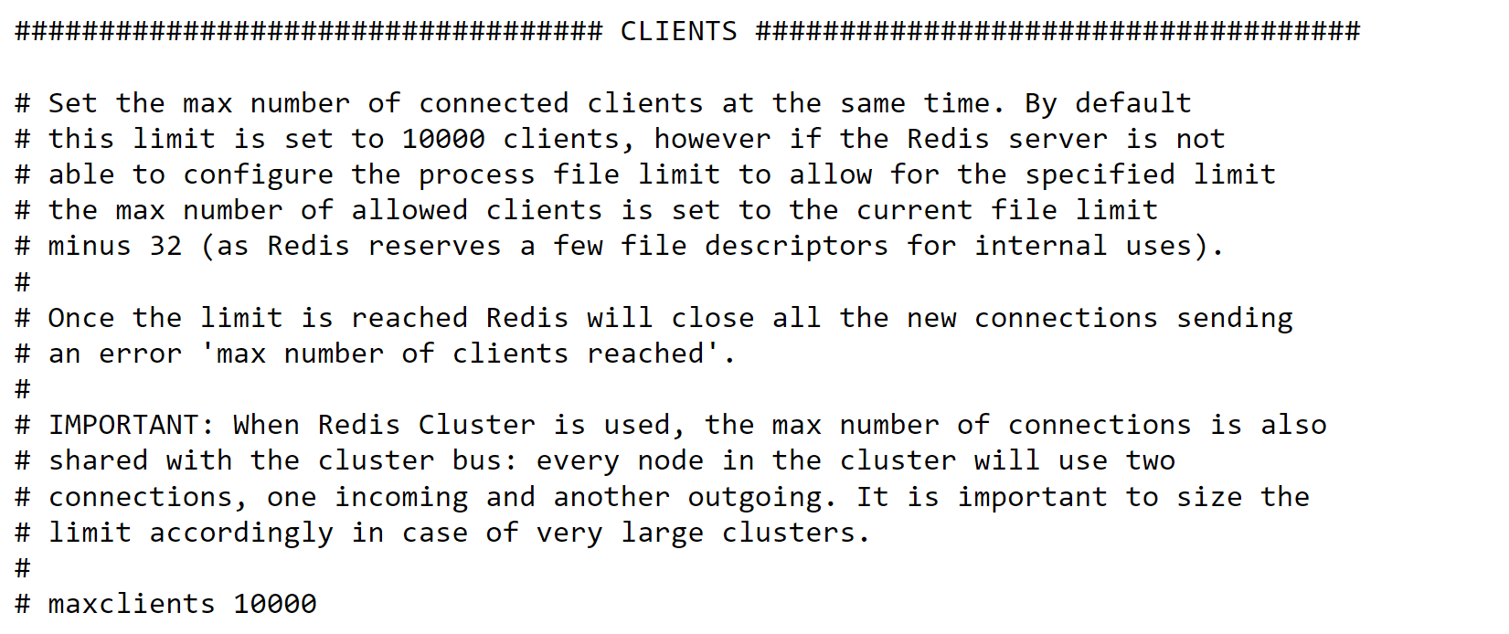
Client Information-Redis Client Handling
Test your self
Client connection work flow
By default it is set to 10000 clients, unless otherwise stated by the maxclients directive in redis.conf.

Slide 7
Steps
Open redis.conf file
maxclients 1
redis-server redis.conf

Slide 8
Client Information-Redis Client Handling
Client timeouts
By default recent versions of Redis don't close the connection with the client if the client is idle for many seconds: the connection will remain open forever.
However if you don't like this behavior, you can configure a timeout, so that if the client is idle for more than the specified number of seconds, the client connection will be closed.
You can configure this limit via redis.conf or simply using CONFIG SET timeout <value>

Slide 9
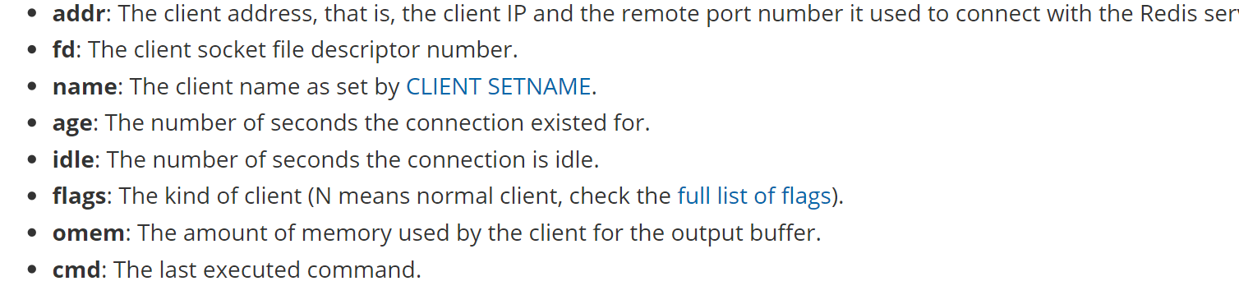
Client Information-Redis Client Handling
CLIENT command
redis 127.0.0.1:6379> client list
addr=127.0.0.1:52555 fd=5 name= age=855 idle=0 flags=N db=0 sub=0 psub=0 multi=-1 qbuf=0 qbuf-free=32768 obl=0 oll=0 omem=0 events=r cmd=client
addr=127.0.0.1:52787 fd=6 name= age=6 idle=5 flags=N db=0 sub=0 psub=0 multi=-1 qbuf=0 qbuf-free=0 obl=0 oll=0 omem=0 events=r cmd=ping

Slide 10
Client Information-Redis Client Handling
Setting client information
client setname myclient
client getname
client list

Slide 11
Slow Log : Monitoring Slow Redis Calls
inspect slow queries
Redis provides us with monitor feature which let us inspect slow queries. Slowlog will log last X amount queries which took more time than Y microseconds to run. You can set this either in redis.conf or at runtime using CONFIG command
CONFIG SET slowlog-log-slower-than 5000
CONFIG SET slowlog-max-len 50
The slowlog-log-slower-than specified above is specified in microseconds, that means it will log all the queries taking time above 5 ms

Slide 12
Slow Log
To Retrieve the slowlog queries, you have to use SLOWLOG GET X. Where X is the number of slow queries you want to retrieve.
SLOWLOG GET 50
Result will display a unique id, timestamp, time taken to execute the query in microseconds, and the actual command + parameter executed.
1) 1) (integer) 0 ## unique id
2) (integer) 1491042367 ## timestamp
3) (integer) 11498 ## time taken
4) 1) "KEYS" ## command
2) 'r:usr:*' ## command paramter
3) “0”

Slide 13
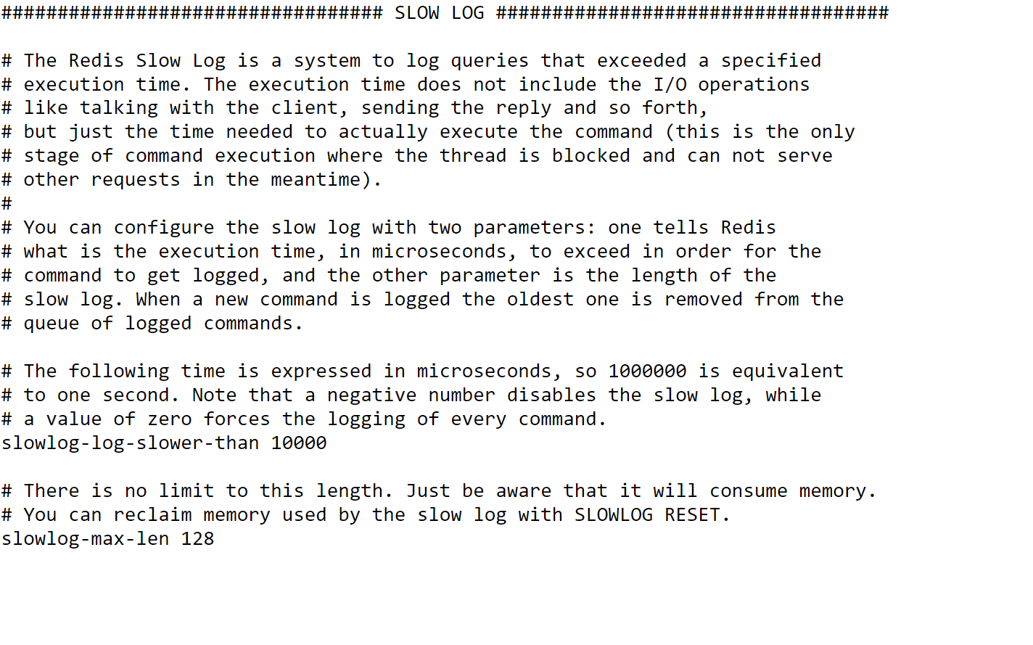

Slide 14
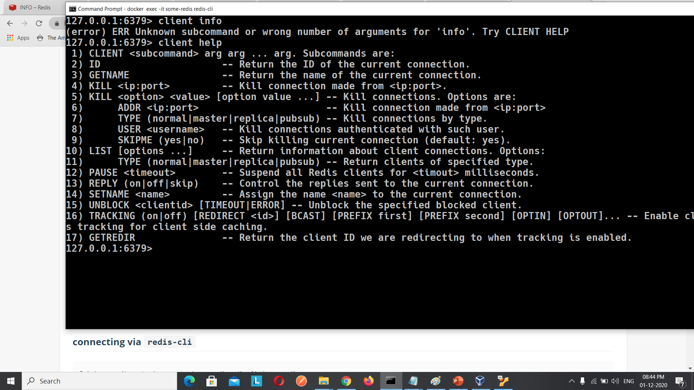

Slide 15
Memory Information-info memory
# Memory
used_memory:866320
used_memory_human:846.02K
used_memory_rss:7532544
used_memory_rss_human:7.18M
used_memory_peak:866320
used_memory_peak_human:846.02K
used_memory_peak_perc:100.18%
used_memory_overhead:819834
used_memory_startup:802848
used_memory_dataset:46486
used_memory_dataset_perc:73.24%
allocator_allocated:1010088
allocator_active:1228800
allocator_resident:3637248
total_system_memory:2084323328
total_system_memory_human:1.94G

Slide 16
maxmemory:0
maxmemory_human:0B
maxmemory_policy:noeviction
allocator_frag_ratio:1.22
allocator_frag_bytes:218712
allocator_rss_ratio:2.96
allocator_rss_bytes:2408448
rss_overhead_ratio:2.07
rss_overhead_bytes:3895296
mem_fragmentation_ratio:9.14
mem_fragmentation_bytes:6708728
mem_not_counted_for_evict:0
mem_replication_backlog:0
mem_clients_slaves:0
mem_clients_normal:16986
mem_aof_buffer:0
mem_allocator:jemalloc-5.1.0
active_defrag_running:0
lazyfree_pending_objects:0

Slide 17
Memory
MEMORY USAGE key [SAMPLES count]
The MEMORY USAGE command reports the number of bytes that a key and its value require to be stored in RAM.
The reported usage is the total of memory allocations for data and administrative overheads that a key its value require.
For nested data types, the optional SAMPLES option can be provided, where count is the number of sampled nested values. By default, this option is set to 5. To sample the all of the nested values, use SAMPLES 0

Slide 18
> SET foo bar
OK
> MEMORY USAGE foo
(integer) 54
> SET cento 01234567890123456789012345678901234567890123
45678901234567890123456789012345678901234567890123456789
OK
127.0.0.1:6379> MEMORY USAGE cento
(integer) 153

Slide 19
Memory Sub Commands
1) MEMORY <subcommand> arg arg ... arg. Subcommands are:
2) DOCTOR - Return memory problems reports.
3) MALLOC-STATS -- Return internal statistics report from the memory allocator.
4) PURGE -- Attempt to purge dirty pages for reclamation by the allocator.
5) STATS -- Return information about the memory usage of the server.
6) USAGE <key> [SAMPLES <count>] -- Return memory in bytes used by <key> and its value. Nested values are sampled up to <count> times (default: 5).

Slide 20
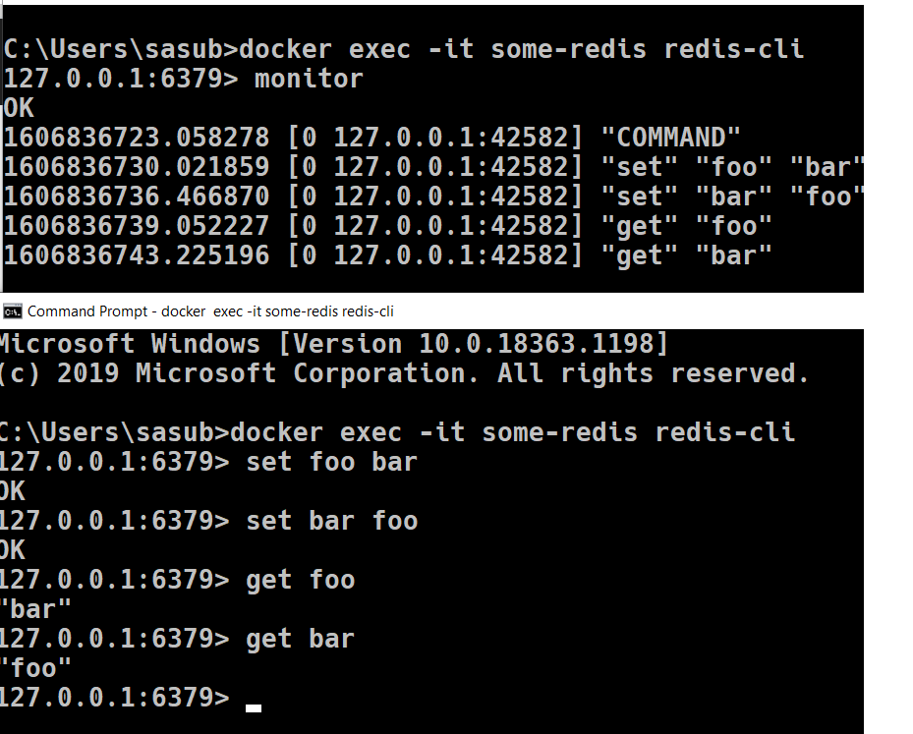
Monitor
MONITOR is a debugging command that streams back every command processed by the Redis server. It can help in understanding what is happening to the database.
Theses commands wont be logged due to security reasons
AUTH
EXEC
HELLO
QUIT

Slide 21
Persistency
Memory is transient.
if a Redis instance is shut down, crashes, or needs to be rebooted, all of the stored data will be lost.
To solve this problem, Redis provides two mechanisms to deal with persistence:
Redis Database (RDB)
Append-only File (AOF).

Slide 22
RDB – Redis Database File
A .rdb file is a binary that has a point in time representing the data stored in a Redis instance.
The RDB file format is optimized for fast reads and writes
To achieve the necessary performance, the internal representation of a .rdb file on a disk is very similar to Redis's in-memory representation.
Another interesting aspect of RDB is that it can use LZF compression to make an RDB file very compact.
LZF compression is a fast compression algorithm that has a very small memory requirement during compression

Slide 23
RDB – Redis Database File
Although it does not have the best compression rates compared to other compression algorithms, it works efficiently with Redis. Also, a single RDB file is sufficient to restore a Redis instance completely.
RDB is great for backups and disaster recovery because it allows you to save an RDB file every hour, day, week, or month, depending on your needs. This approach allows you to easily use RDB files to restore any dataset at any given time.

Slide 24
RDB – Redis Database File
The command SAVE creates an RDB immediately, but it should be avoided because it blocks the Redis server during snapshot creation.
The command BGSAVE (background save) should be used instead; it has the same effect as SAVE, but it runs in a child process so as not to block Redis.
In order to avoid performance degradation during a background save, the redis-server process creates a child process (fork) to perform all the persistence operations.

Slide 25
RDB – Redis Database File
So, the main process will never perform any disk I/O operations.
During this process, if the main redis-server is receiving writes, the child process will need to copy the memory pages that were changed, and this may increase the total used memory significantly (it uses copy-on-write).

Slide 26
Snapshotting
The default Redis configuration file has enabled three snapshot rules to cause the data to persist on the disk through the directive save, which performs background saves This technique is called snapshotting .
“redis.conf” file having the below configuration
save 900 1
save 300 10
save 60 10000

Slide 27
Snapshot Rules
Redis creates snapshots based on two conditions:
if in X seconds, Y amount of write operations have happened in your Redis instance, it will create a .rdb file.
The RDB filename is based on the directive dbfilename (this defaults to dump.rdb) .
save number_of_seconds number_of_changes
With this in mind, we can infer what those three lines will do:
Save a .rdb file on disk every 900 seconds (15 minutes) if at least one write operation happens.
Save a .rdb file on disk every 300 seconds (5 minutes) if at least 10 write operations happen.
Save a .rdb file on disk every 60 seconds (1 minute) if at least 10,000 write operations happen.

Slide 28
Snapshot Lab
Change redis.conf file and check
Save and bgsave commands and check the status

Slide 29
Snapshot Lab
Set a 1
Set b 2
Set c 3
Set d 4
Set e 5
Set g 6
Check ls –l in the redis home dir, can see time stamp for .rdb file

Slide 30
Not recommended to use save directives less than 30 seconds

Slide 31
How to disable snapshot
Snapshotting can be disabled, which means that nothing will be saved on the disk.
This is done by deleting or commenting all save directives in the redis.conf file and then restarting the Redis server.
It can also be disabled via a command-line option or the command CONFIG SET

Slide 32
Snapshot Drawbacks
RDB is not a 100% guaranteed data recovery approach, even if you save snapshots every minute and with at least 100 changes. If the main Redis process stops for any reason, be prepared to lose the latest writes in your database.
Another downside to RDB is that every time that you need to create a snapshot, the Redis main process will execute a fork() to create a child process to cause the data to persist on the disk.
It can make your Redis instance stop serving clients for milliseconds, sometimes even for a few seconds, depending on the hardware and the size of the dataset.

Slide 33
Snapshot additional directives
stop-writes-on-bgsave-error: The possible values for this are yes or no. This option makes Redis stop accepting writes if the last background save has failed. Redis starts accepting writes again after a background save succeeds. The default value is yes
rdbcompression: The possible values for this are yes or no. When this option is set to yes, Redis uses LZF compression for the .rdb files. The default value is yes
rdbchecksum: The possible values for this are yes or no. When it is set to yes, Redis saves a checksum at the end of the .rdb file and performs a checksum before loading the .rdb file. Redis does not start if the RDB checksum does not match with the one in the file. The default value is yes
dbfilename: This option sets the .rdb filename. The default value is dump.rdb
save: This option configures the snapshot frequency, based on the number of seconds and changes. It can be specified multiple times. The default values are save 3600 1, save 300 100, and save 60 10000
dir: This specifies the directory location of the AOF and RDB files

Slide 34
AOF (Append-only File)
The AOF persistence logs every write operation received by the server, that will be played again at server startup, reconstructing the original dataset.
Commands are logged using the same format as the Redis protocol itself, in an append-only fashion.
Redis is able to rewrite the log in the background when it gets too big.

Slide 35
AOF (Append-only File)
When AOF is enabled, every time Redis receives a command that changes the dataset, it will append that command to the AOF (Append-only File). With this being said, if you have AOF enabled and Redis is restarted, it will restore the data by executing all commands listed in AOF, preserving the order, and rebuild the state of the dataset. AOF is an alternative to RDB snapshotting.

Slide 36
AOF (Append-only File)
AOF is a "human-readable" append-only log file.
This means that there are no seeks and corruption problems can be easily identified.
You can even open this file in a text editor and understand what is inside (which is impossible to do with an RDB file, since it is binary).

Slide 37
AOF (Append-only File)
An interesting point to note about AOF is that even in the event of the AOF being incomplete or corrupted for whatever reason, there is a tool called redis-check-aof that checks and fixes AOF files easily.

Slide 38
Lab
BGREWRITEAOF. Command will triger aof save

Slide 39
AOF - Directives
appendonly: This will enable or disable AOF. The options available are yes and no. By default, AOF is disabled
appendfilename: This specifies the AOF filename. This field is for a filename only, not a file path. It is empty by default
appendfsync: Redis uses a background thread to perform fsync() in the main process (fsync() is a system call that tells the OS to flush data to disk). Redis allows you to configure the fsync policy in three possible ways
: no: Do not execute fsync(); let the OS decide when to flush the data. This is the fastest option
always: Execute fsync() after every write. This is the slowest option, but also the safest
everysec: Execute fsync() once every second. This still provides good write performance. This is the default value

Slide 40
AOF - Directives
no-appendfsync-on-rewrite: The possible values are yes and no. If the appendfsync policy is set to everysec or always and a background save or AOF log rewrite is taking place, Redis may block due to a lot of disk I/O (the fsync() syscall will be long). You should only enable this option if you have latency problems. The default value is no
auto-aof-rewrite-percentage: The valid values range from 0 to 100. Redis is able to automatically rewrite the log file by implicitly executing the command BGREWRITEAOF when the AOF size grows by the specified percentage. The default value is 100
• auto-aof-rewrite-min-size: This is the minimum size for AOF to be rewritten. This prevents AOF rewrites until the specified minimum size is reached, even if the specified auto-aof-rewrite-percentage value is exceeded. The default value is 67,108,864 bytes
• aof-load-truncated: The possible values are yes and no. In the event of a crash, the AOF may get truncated, and this option specifies whether Redis should load the truncated AOF on startup or exit with an error. When the value is yes, Redis will load the truncated file and emit an error message. When it is no, Redis will exit with an error and not load the truncated file
• dir: This specifies the directory location of the AOF and RDB files

Slide 41
AOF OR RDB
Restoring data from an RDB is faster than AOF when recovering a big dataset. This is because an RDB does not need to re-execute every change made in the entire database; it only needs to load the data that was previously stored.
For instance, imagine that you have a key called pageview and it starts with a value of 1. Suppose that a day has passed and now the value of pageview is 100000 (since you had this number of visits and the command INCR was executed for each visit). If you have to restore your database using AOF, Redis will execute 100,000 INCR commands to get the last value of the key. But when restoring using RDB, Redis will create a key with a value of 100000 right away, which is much faster
Although RDB and AOF are different strategies, they can be enabled at the same time.
Redis will load RDB or AOF on startup if any of the files exists. If both files exist, the AOF takes precedence because of its durability guarantees.

Slide 42
AOF OR RDB
The following are some considerations when using persistence in Redis:
If your application does not need persistence, disable RDB and AOF
If your application has tolerance to data loss, use RDB
If your application requires fully durable persistence, use both RDB and AOF

Slide 43
Persistency Options info command

Slide 44
loading: Flag indicating if the load of a dump file is on-going
rdb_changes_since_last_save: Number of changes since the last dump
rdb_bgsave_in_progress: Flag indicating a RDB save is on-going
rdb_last_save_time: Epoch-based timestamp of last successful RDB save
rdb_last_bgsave_status: Status of the last RDB save operation
rdb_last_bgsave_time_sec: Duration of the last RDB save operation in seconds
rdb_current_bgsave_time_sec: Duration of the on-going RDB save operation if any
rdb_last_cow_size: The size in bytes of copy-on-write allocations during the last RDB save operation
aof_enabled: Flag indicating AOF logging is activated
aof_rewrite_in_progress: Flag indicating a AOF rewrite operation is on-going
aof_rewrite_scheduled: Flag indicating an AOF rewrite operation will be scheduled once the on-going RDB save is complete.
aof_last_rewrite_time_sec: Duration of the last AOF rewrite operation in seconds
aof_current_rewrite_time_sec: Duration of the on-going AOF rewrite operation if any
aof_last_bgrewrite_status: Status of the last AOF rewrite operation
aof_last_write_status: Status of the last write operation to the AOF
aof_last_cow_size: The size in bytes of copy-on-write allocations during the last AOF rewrite operation

Slide 45
module_fork_in_progress: Flag indicating a module fork is on-going
module_fork_last_cow_size: The size in bytes of copy-on-write allocations during the last module fork operation
rdb_changes_since_last_save refers to the number of operations that produced some kind of changes in the dataset since the last time either SAVE or BGSAVE was called.
If AOF is activated, these additional fields will be added:
aof_current_size: AOF current file size
aof_base_size: AOF file size on latest startup or rewrite
aof_pending_rewrite: Flag indicating an AOF rewrite operation will be scheduled once the on-going RDB save is complete.
aof_buffer_length: Size of the AOF buffer
aof_rewrite_buffer_length: Size of the AOF rewrite buffer
aof_pending_bio_fsync: Number of fsync pending jobs in background I/O queue
aof_delayed_fsync: Delayed fsync counter
If a load operation is on-going, these additional fields will be added:
loading_start_time: Epoch-based timestamp of the start of the load operation
loading_total_bytes: Total file size
loading_rdb_used_mem: The memory usage of the server that had generated the RDB file at the time of the file's creation
loading_loaded_bytes: Number of bytes already loaded
loading_loaded_perc: Same value expressed as a percentage
loading_eta_seconds: ETA in seconds for the load to be complete

Slide 46
General Statistics Information
total_connections_received: Total number of connections accepted by the server
total_commands_processed: Total number of commands processed by the server
instantaneous_ops_per_sec: Number of commands processed per second
total_net_input_bytes: The total number of bytes read from the network
total_net_output_bytes: The total number of bytes written to the network
instantaneous_input_kbps: The network's read rate per second in KB/sec
instantaneous_output_kbps: The network's write rate per second in KB/sec
rejected_connections: Number of connections rejected because of maxclients limit

Slide 47
sync_full: The number of full resyncs with replicas
sync_partial_ok: The number of accepted partial resync requests
sync_partial_err: The number of denied partial resync requests
expired_keys: Total number of key expiration events
expired_stale_perc: The percentage of keys probably expired
expired_time_cap_reached_count: The count of times that active expiry cycles have stopped early
expire_cycle_cpu_milliseconds: The cumulative amount of time spend on active expiry cycles
evicted_keys: Number of evicted keys due to maxmemory limit
keyspace_hits: Number of successful lookup of keys in the main dictionary

Slide 48
keyspace_misses: Number of failed lookup of keys in the main dictionary
pubsub_channels: Global number of pub/sub channels with client subscriptions
pubsub_patterns: Global number of pub/sub pattern with client subscriptions
latest_fork_usec: Duration of the latest fork operation in microseconds
migrate_cached_sockets: The number of sockets open for MIGRATE purposes
slave_expires_tracked_keys: The number of keys tracked for expiry purposes (applicable only to writable replicas)
active_defrag_hits: Number of value reallocations performed by active the defragmentation process
active_defrag_misses: Number of aborted value reallocations started by the active defragmentation process
active_defrag_key_hits: Number of keys that were actively defragmented
active_defrag_key_misses: Number of keys that were skipped by the active defragmentation process
tracking_total_keys: Number of keys being tracked by the server
tracking_total_items: Number of items, that is the sum of clients number for each key, that are being tracked

Slide 49
tracking_total_prefixes: Number of tracked prefixes in server's prefix table (only applicable for broadcast mode)
unexpected_error_replies: Number of unexpected error replies, that are types of errors from an AOF load or replication
total_reads_processed: Total number of read events processed
total_writes_processed: Total number of write events processed
io_threaded_reads_processed: Number of read events processed by the main and I/O threads
io_threaded_writes_processed: Number of write events processed by the main and I/O threads

Slide 50
CPU information
used_cpu_sys: System CPU consumed by the Redis server
used_cpu_user:User CPU consumed by the Redis server
used_cpu_sys_children: System CPU consumed by the background processes
used_cpu_user_children: User CPU consumed by the background processes

Slide 51
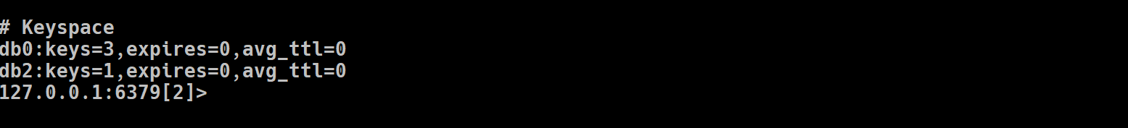
Keyspace(database) statstics
Data base Related Information
For each database, the following line is added:
dbXXX: keys=XXX,expires=XXX

Slide 52
Database Information
Total 0 to 15 databases
Default is 0 database is selected
Changing database
Select 1
Getting db size
dbsize
Return the number of keys in the currently-selected database.
Deleting all keys
FLUSHDB [ASYNC] – single db
FLUSHALL [ASYNC] – delete all keys in all databases-16 database
Swap db
Swapdb 0 1

Slide 53
Redis latency monitoring framework
Redis is often used in the context of demanding use cases, where it serves a large number of queries per second per instance, and at the same time, there are very strict latency requirements both for the average response time and for the worst case latency.
While Redis is an in-memory system, it deals with the operating system in different ways, for example, in the context of persisting to disk. Moreover Redis implements a rich set of commands. Certain commands are fast and run in constant or logarithmic time, other commands are slower O(N) commands that can cause latency spikes.

Slide 54
Redis latency monitoring framework
Finally Redis is single threaded: this is usually an advantage from the point of view of the amount of work it can perform per core, and in the latency figures it is able to provide, but at the same time it poses a challenge from the point of view of latency, since the single thread must be able to perform certain tasks incrementally, for example key expiration, in a way that does not impact the other clients that are served

Slide 55
How to enable latency monitoring
To enable the latency monitor is to set a latency threshold in milliseconds. Only events that will take more than the specified threshold will be logged as latency spikes.
Lab
CONFIG SET latency-monitor-threshold 100

Slide 56
Information reporting with the LATENCY command
The user interface to the latency monitoring subsystem is the LATENCY command. Like many other Redis commands, LATENCY accepts subcommands that modifies its behavior. These subcommands are:
LATENCY LATEST - returns the latest latency samples for all events.
LATENCY HISTORY - returns latency time series for a given event.
LATENCY RESET - resets latency time series data for one or more events.
LATENCY GRAPH - renders an ASCII-art graph of an event's latency samples.
LATENCY DOCTOR - replies with a human-readable latency analysis report.

Slide 57
127.0.0.1:6379> CONFIG SET latency-monitor-threshold 100
OK
127.0.0.1:6379> debug sleep 1
OK
(1.00s)
127.0.0.1:6379> latency latest
1) 1) "command"
2) (integer) 1606872783
3) (integer) 1000
4) (integer) 1000
127.0.0.1:6379> debug sleep .25
OK
127.0.0.1:6379> latency latest
1) 1) "command"
2) (integer) 1606872827
3) (integer) 250
4) (integer) 1000
127.0.0.1:6379> latency history command
1) 1) (integer) 1606872783
2) (integer) 1000
2) 1) (integer) 1606872827
2) (integer) 250
127.0.0.1:6379> latency doctor

Slide 58
127.0.0.1:6379> latency reset command
(integer) 1
127.0.0.1:6379> debug sleep .1
OK
127.0.0.1:6379> debug sleep .2
OK
127.0.0.1:6379> debug sleep .3
OK
127.0.0.1:6379> debug sleep .5
OK
(0.50s)
127.0.0.1:6379> debug sleep .4

Slide 59
OK
127.0.0.1:6379> latency graph command
command - high 500 ms, low 100 ms (all time high 500 ms)
--------------------------------------------------------------------------------
#_
_||
_|||
_||||
22219
9523s
ssss
127.0.0.1:6379>

Slide 60
ACL – Access Control List
The Redis ACL, short for Access Control List, is the feature that allows certain connections to be limited in terms of the commands that can be executed and the keys that can be accessed.
The way it works is that, after connecting, a client is required to authenticate providing a username and a valid password: if the authentication stage succeeded, the connection is associated with a given user and the limits the user has.

Slide 61
ACL – Access Control List
Redis can be configured so that new connections are already authenticated with a "default" user (this is the default configuration).
configuring the default user has, as a side effect, the ability to provide only a specific subset of functionalities to connections that are not explicitly authenticated.

Slide 62
WHY ACL
Preventing libraries from calling KEYS on a production server
Preventing administrators from calling FLUSHALL by mistake
Designating a key prefix for sensitive information that only some users can access

Slide 63
Authentication Patterns
If the Redis server is password protected via the requirepass option.
If a Redis 6.0 instance, or greater, is using the Redis ACL system.

Slide 64
ACL Syntax history
user <username> ... acl rules ...
user worker +@list +@connection ~jobs:* on >ffa9203c493aa99
Rules
# on Enable the user: it is possible to authenticate as this user.
# off Disable the user: it's no longer possible to authenticate
# with this user, however the already authenticated connections
# will still work.
# +<command> Allow the execution of that command
# -<command> Disallow the execution of that command

Slide 65
ACL Syntax history
+@<category>
Allow the execution of all the commands in such category
with valid categories are like @admin, @set, @sortedset, ...
and so forth, see the full list in the server.c file where
the Redis command table is described and defined.
The special category @all means all the commands, but currently
present in the server, and that will be loaded in the future
via modules.

Slide 66
ACL Syntax history
+<command>|subcommand
Allow a specific subcommand of an otherwise disabled command. Note that this form is not allowed as negative like -DEBUG|SEGFAULT, but only additive starting with "+".
allcommands Alias for +@all. Note that it implies the ability to execute
all the future commands loaded via the modules system.
nocommands Alias for -@all.

Slide 67
ACL Syntax history
# ~<pattern> Add a pattern of keys that can be mentioned as part of
# commands. For instance ~* allows all the keys. The pattern
# is a glob-style pattern like the one of KEYS.
# It is possible to specify multiple patterns.
# allkeys Alias for ~*
# resetkeys Flush the list of allowed keys patterns.
# ><password> Add this password to the list of valid password for the user.
# For example >mypass will add "mypass" to the list.
# This directive clears the "nopass" flag (see later).
# <<password> Remove this password from the list of valid passwords.
#

Slide 68
ACL Syntax history
nopass All the set passwords of the user are removed, and the user
# is flagged as requiring no password: it means that every
# password will work against this user. If this directive is
# used for the default user, every new connection will be
# immediately authenticated with the default user without
# any explicit AUTH command required. Note that the "resetpass"
# directive will clear this condition.
# resetpass Flush the list of allowed passwords. Moreover removes the
# "nopass" status. After "resetpass" the user has no associated
# passwords and there is no way to authenticate without adding
# some password (or setting it as "nopass" later).
# reset Performs the following actions: resetpass, resetkeys, off,
# -@all. The user returns to the same state it has immediately
# after its creation.
#

Slide 69
ACL Rules order
ACL rules can be specified in any order: for instance you can start with
passwords, then flags, or key patterns. However note that the additive
and subtractive rules will CHANGE MEANING depending on the ordering.
For instance see the following example:
# user alice on +@all -DEBUG ~* >somepassword

Slide 70
ACL Rules order
This will allow "alice" to use all the commands with the exception of the
DEBUG command, since +@all added all the commands to the set of the commands
alice can use, and later DEBUG was removed. However if we invert the order
of two ACL rules the result will be different:
#
user alice on -DEBUG +@all ~* >somepassword
#
# Now DEBUG was removed when alice had yet no commands in the set of allowed
# commands, later all the commands are added, so the user will be able to
# execute everything.
#
# Basically ACL rules are processed left-to-right

Slide 71
Lab
Create User
Set Acls
Play around

Slide 72
ACL commands
127.0.0.1:6379> acl help
1) ACL <subcommand> arg arg ... arg. Subcommands are:
2) LOAD -- Reload users from the ACL file.
3) SAVE -- Save the current config to the ACL file.
4) LIST -- Show user details in config file format.
5) USERS -- List all the registered usernames.
6) SETUSER <username> [attribs ...] -- Create or modify a user.
7) GETUSER <username> -- Get the user details.
8) DELUSER <username> [...] -- Delete a list of users.
9) CAT -- List available categories.
10) CAT <category> -- List commands inside category.
11) GENPASS [<bits>] -- Generate a secure user password.
12) WHOAMI -- Return the current connection username.
13) LOG [<count> | RESET] -- Show the ACL log entries.
127.0.0.1:6379>

Slide 73
Redis Signals Handling
What Is Linux SIGTERM Signal
The SIGTERM signal is a generic signal used to terminate a program
SIGTERM provides an elegance way to kill program.
What is the difference between the SIGINT
SIGINT is the interrupt signal. The terminal sends it to the foreground process when the user presses ctrl-c. The default behavior is to terminate the process

Slide 74
Once one of these signals is trapped, Redis aborts any current operation and performs the following actions
A bug report is produced on the log file. This includes a stack trace, dump of registers, and information about the state of clients.
Since Redis 2.8 a fast memory test is performed as a first check of the reliability of the crashing system.
If the server was daemonized, the pid file is removed.
Finally the server unregisters its own signal handler for the received signal, and sends the same signal again to itself, in order to make sure that the default action is performed, for instance dumping the core on the file system.

Slide 75
Handling of SIGSEGV, SIGBUS, SIGFPE and SIGILL
The following follow signals are handled as a Redis crash:
SIGSEGV : segmentation fault
SIGBUS : SignalBus
SIGFPE : Client Program Error
SIGILL : Kill

Slide 76
Replication :Scalability
Replication means that while you write to a Redis instance (usually referred to as the master), it will ensure that one or more instances (usually referred to as the replica) become exact copies of the master.
One Leader(Master) many followers(replicas)

Slide 77
Replication is another Persistency Diskless Persistency

Slide 78
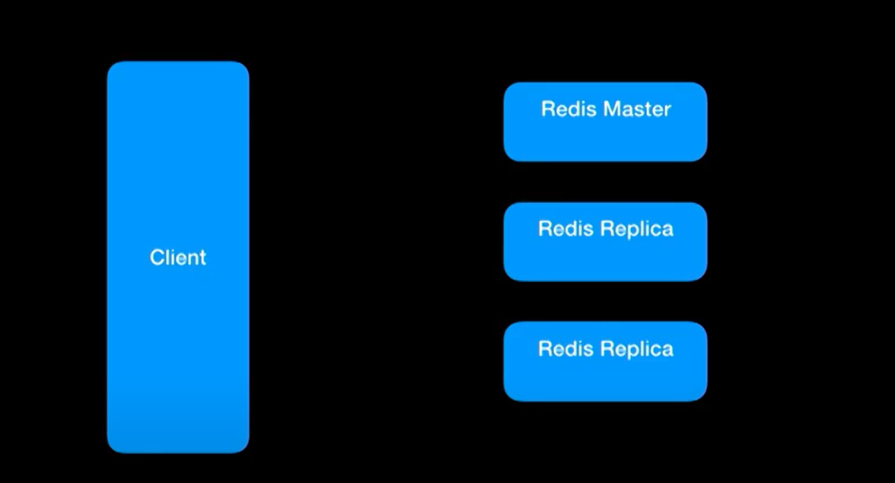
Replication Basics

Slide 79
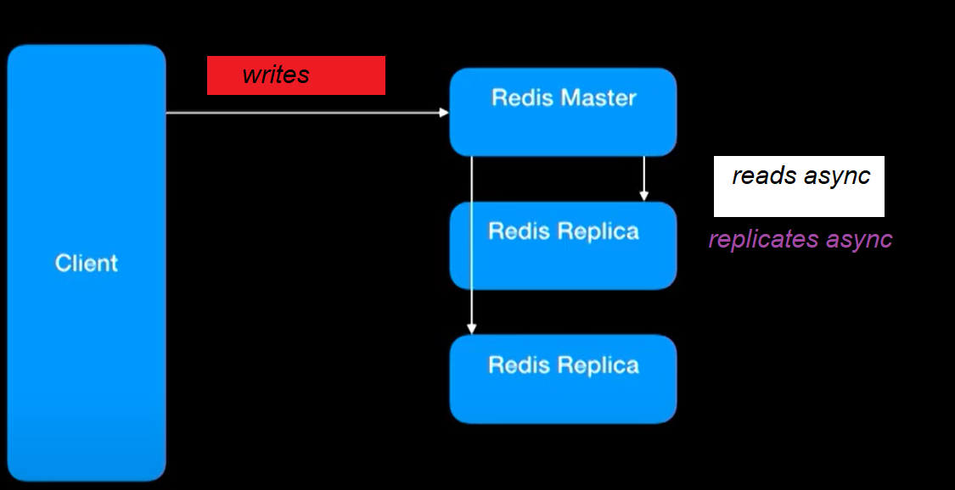
Replication Basics

Slide 80
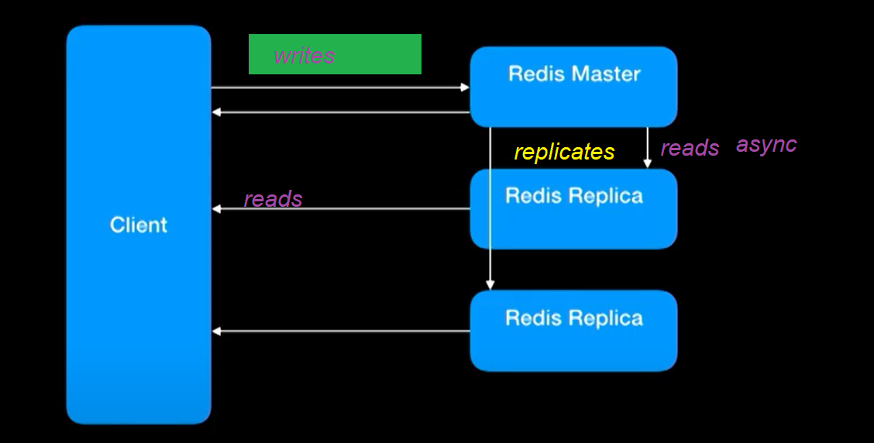
Replication Basics

Slide 81
Replication Basics
RDB / AOF

Slide 82
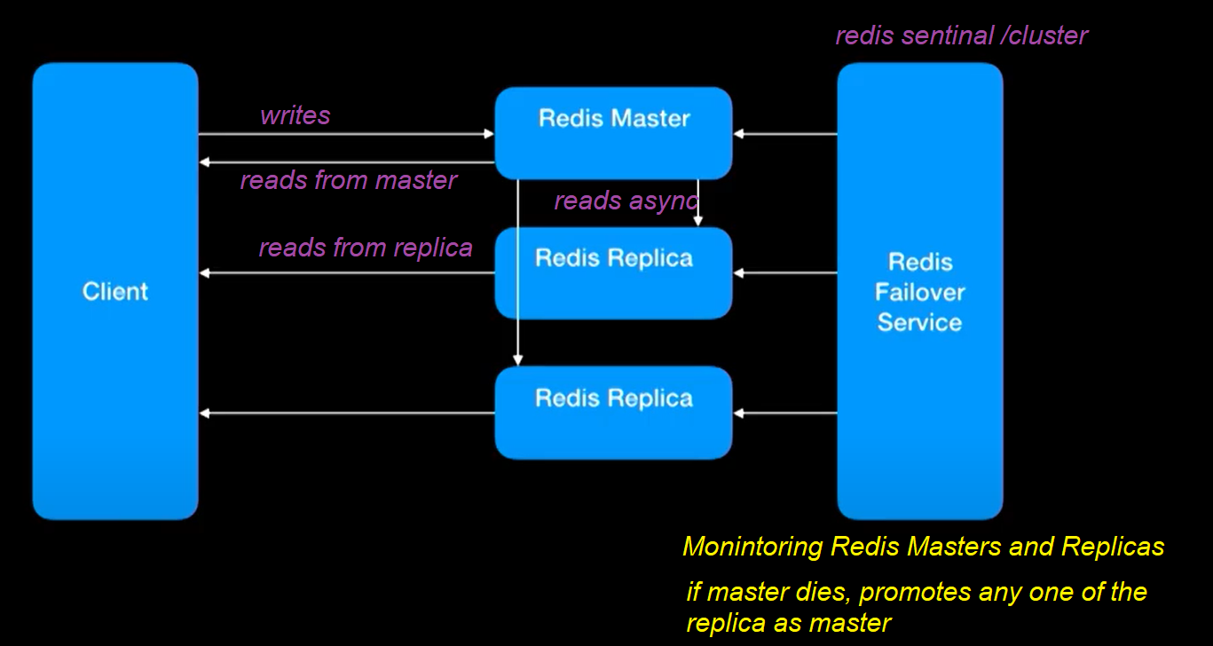
Replication Basics

Slide 83
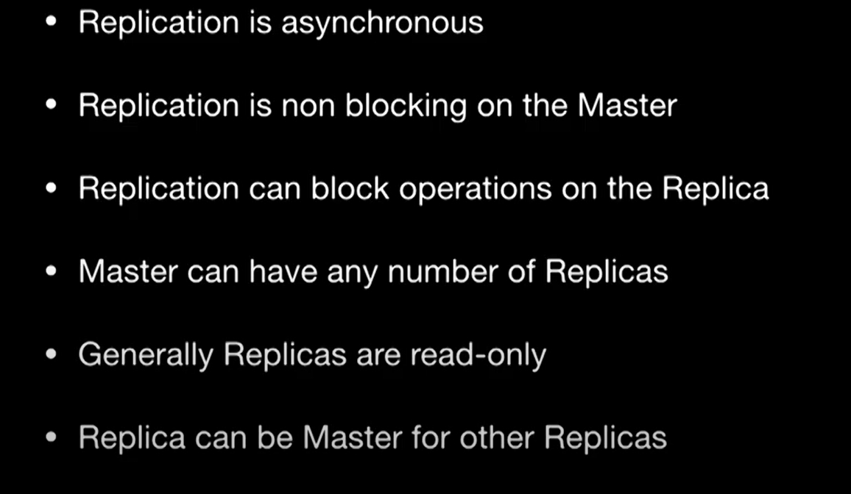

Slide 84
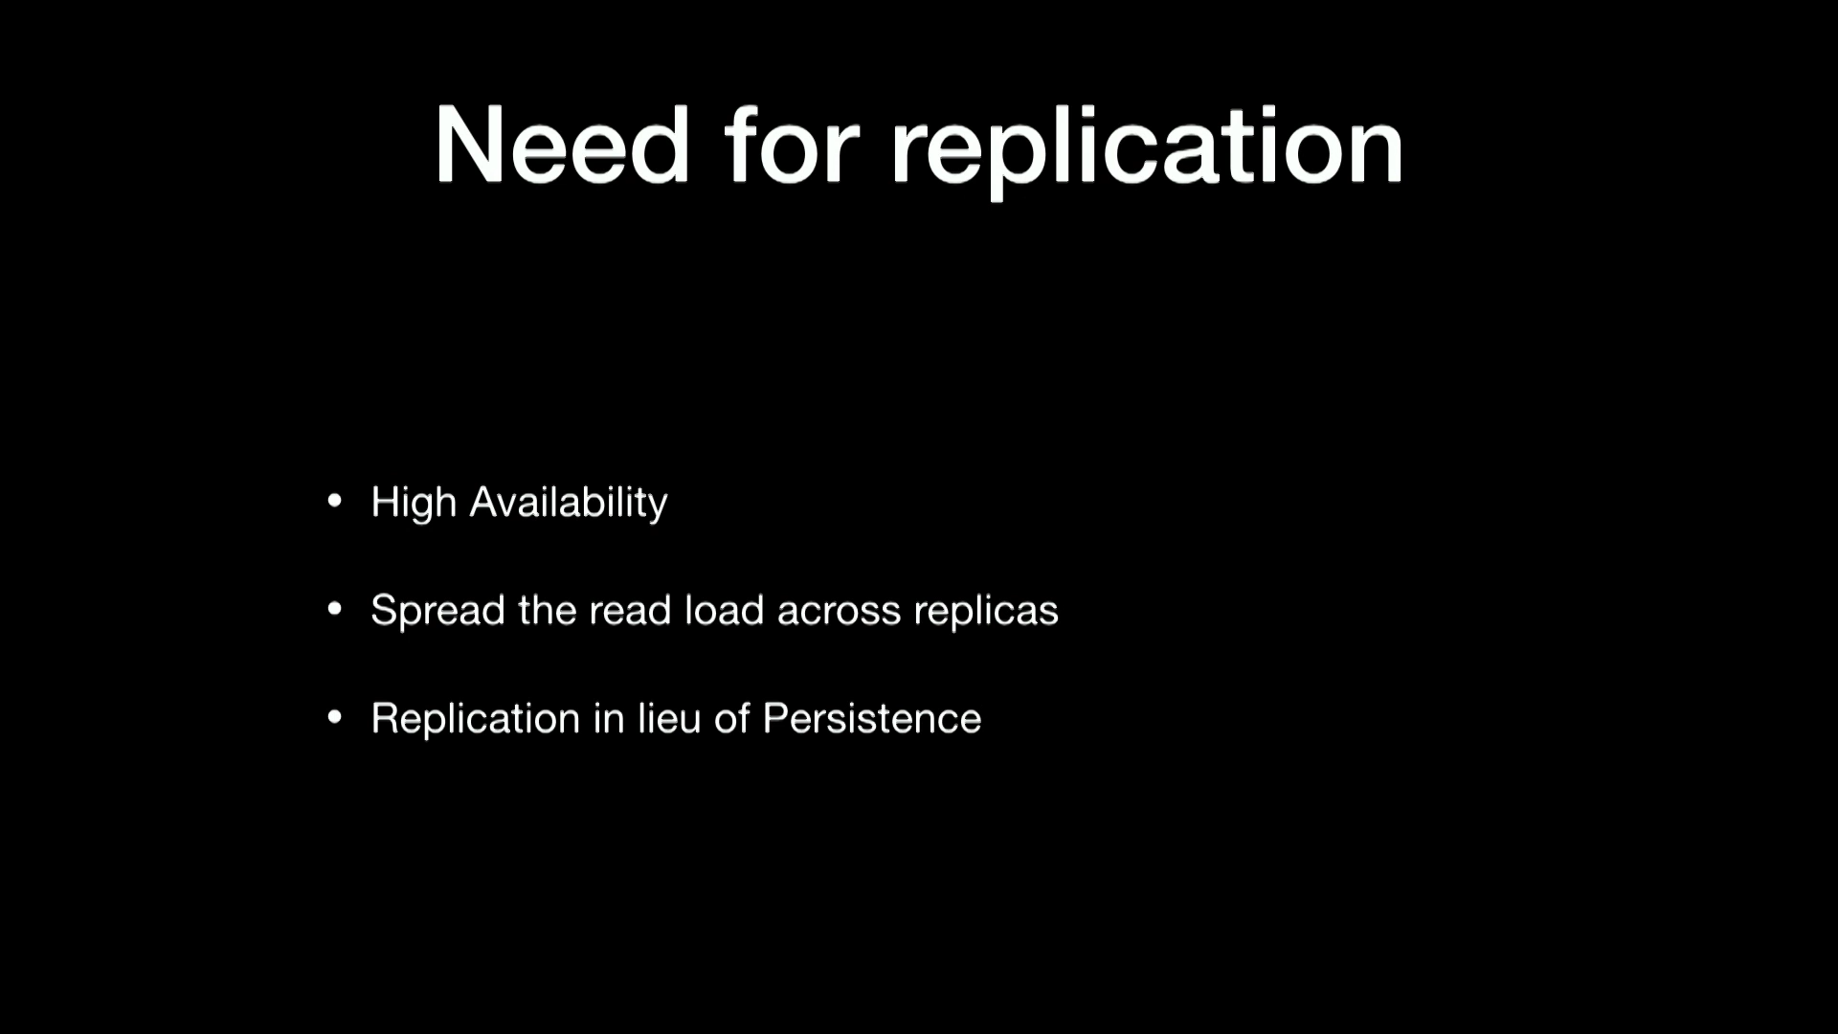

Slide 85
Types of Replication
Full Sync
Partial Sync

Slide 86
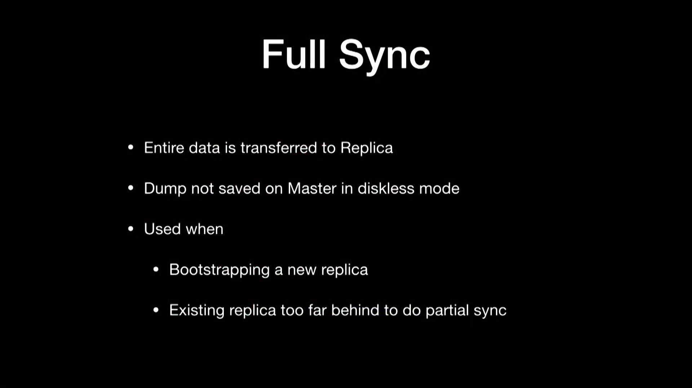
Types of Replication

Slide 87
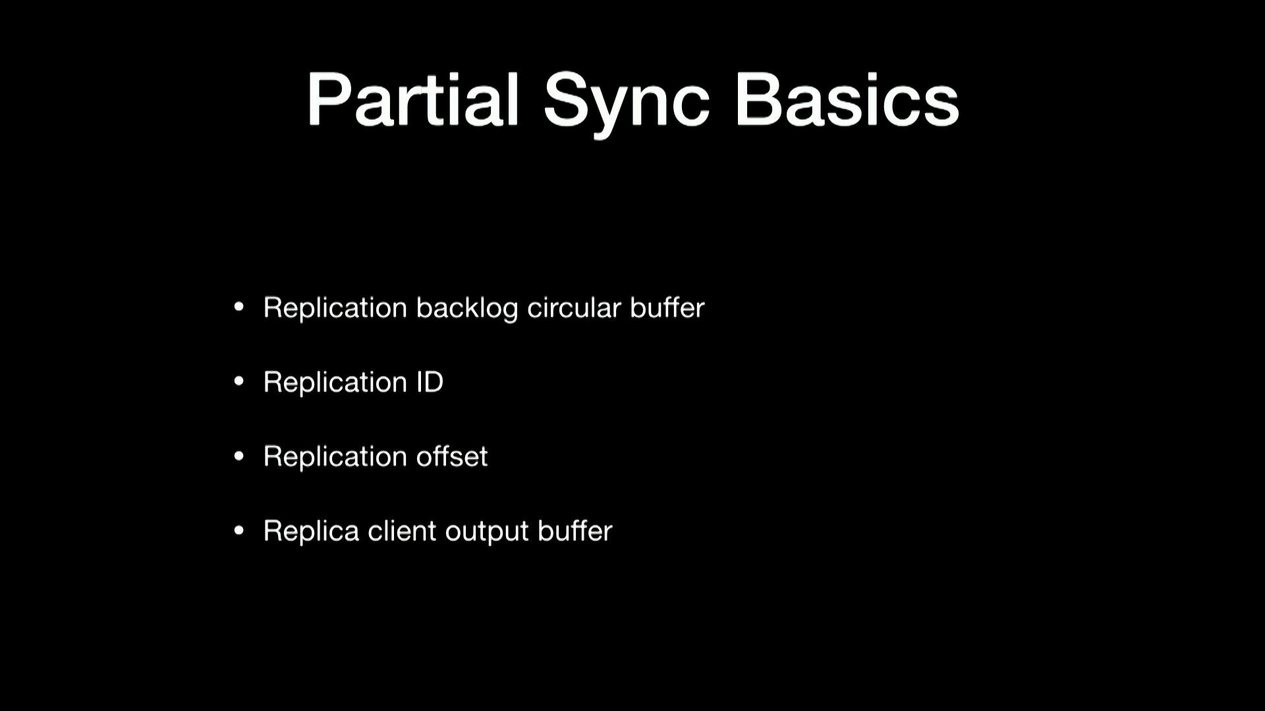

Slide 88
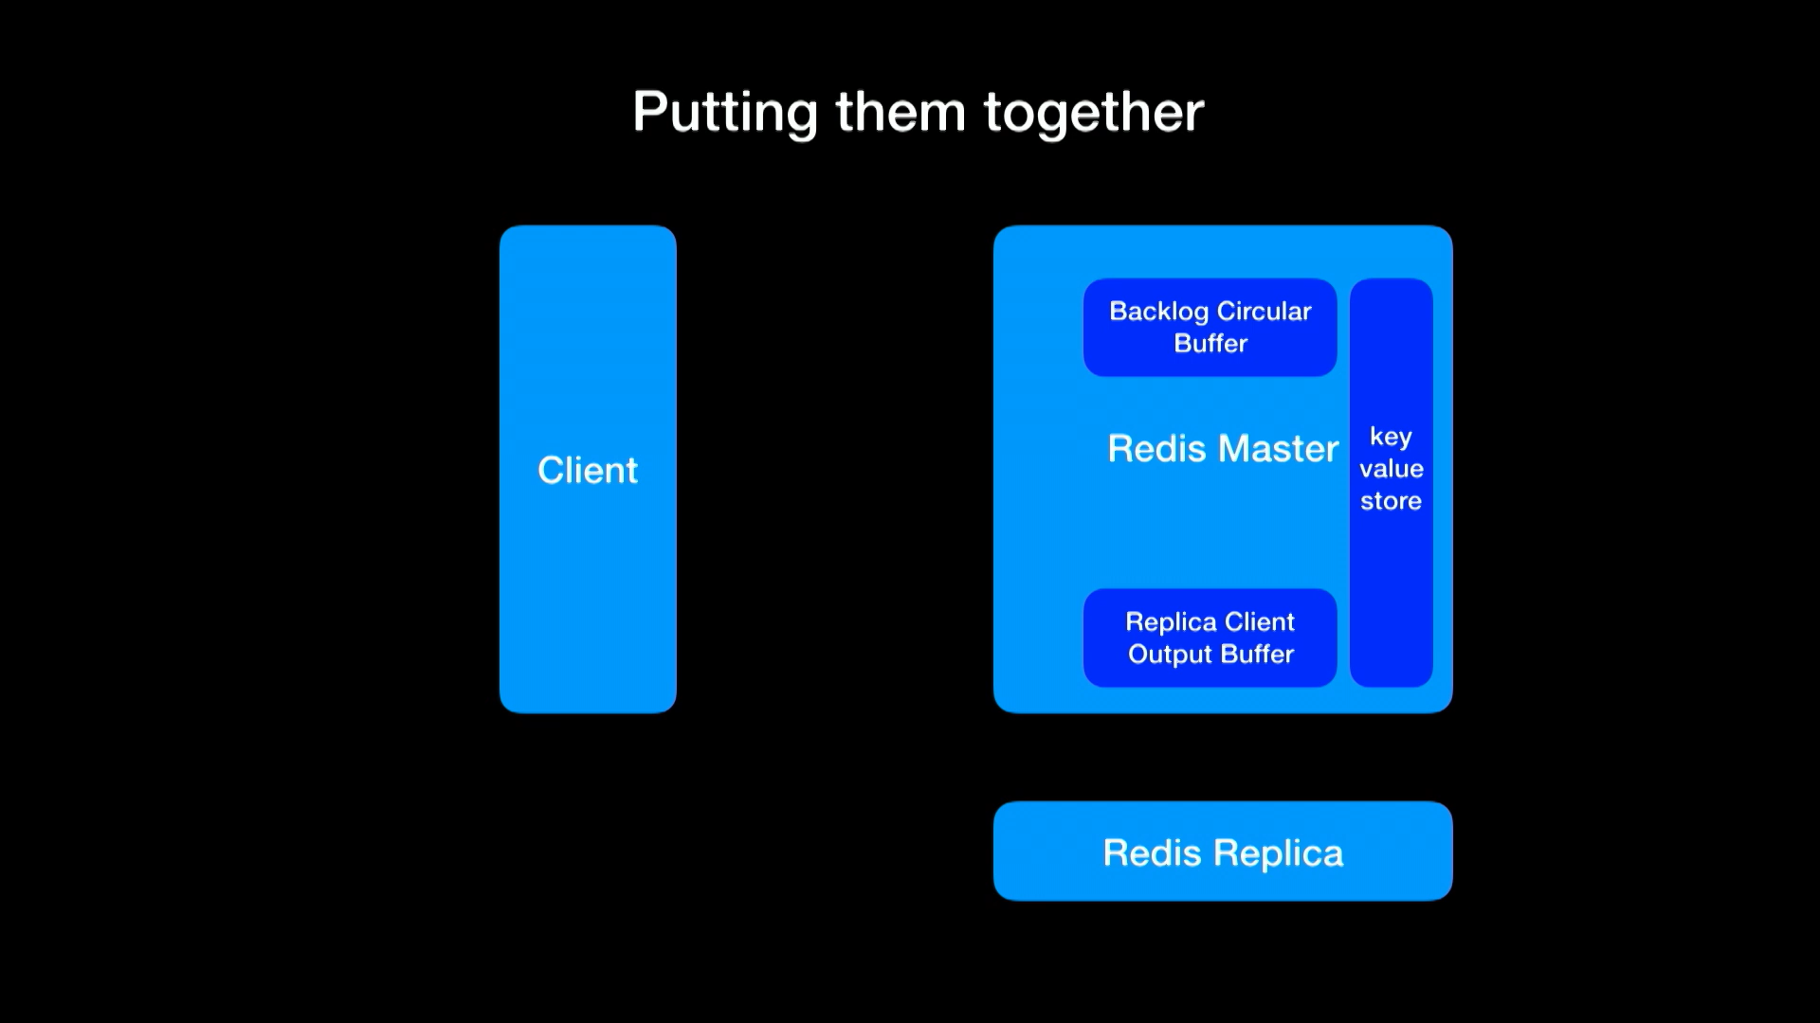

Slide 89
Create Slaves(Replicas) and Master
There are Three ways of making a Redis server instance a slave:
Add the directive slaveof IP PORT to the configuration file and start a Redis server using this configuration
Use the redis-server command-line option --slaveof IP PORT
Use the command SLAVEOF IP PORT

Slide 90
Partitioning
Partitioning is a general term used to describe the act of breaking up data and distributing it across different hosts.
Breaking One Master Database data and share across multiple masters

Slide 91
Why Partitioning
Partitioning is performed in a cluster of hosts when better performance, maintainability, or availability is desired.
When Redis was initially designed, it had no intention to be a distributed data store; thus, it cannot natively distribute its data among different instances. It was designed to work well on a single server.
Redis Cluster is designed to solve distributed problems in Redis.

Slide 92
Types of Partitioning
Horizontal partitioning
Vertical partitioning

Slide 93
Sharding
Horizontal partitioning means distributing keys across different Redis instances
Vertical partitioning means distributing key values across different Redis instances.
For example, if you have two Redis Sets stored in Redis, horizontal partitioning would distribute each Set entirely to a different Redis instance, while vertical partitioning would distribute the Set's values to different instances
Horizontal partitioning (also known as sharding) is the most popular approach adopted with Redis

Slide 94
Horizontal partitioning Techniques: Range partitioning
Range partitioning is very simple; data is distributed based on a range of keys. Assuming that the keys you want to partition are based on incremental IDs, you can create numerical ranges to partition the data. For example, assuming that you have a group of users identified by IDs (such as user:1, user:2, and so on up to user:5000) you can split these IDs into ranges of thousands. Then you can send keys that go from 1 to 1000 to a given instance, 1001 to 2000 to a different instance, 2001 to 3000 to another instance, and so on.

Slide 95
Horizontal partitioning Techniques: Hash partitioning
Hash partitioning is very simple to implement. It consists of finding the instance to send the commands by applying a hash function to the Redis key, dividing this hash value by the number of Redis instances available, and using the remainder of that division as the instance index.
var index = hashFunction(redisKey) % redisHosts.length;
var host = redisHosts[index];

Slide 96
Master –Slave Architecture : Our Expectations
The master has enough memory to store all of the data that you need
More slaves can be added to scale reads better or when network bandwidth is a problem (the total read volume is higher than the hardware capability)
It is acceptable to stop your application when maintenance is required on the master machine
Data redundancy through slaves is enough

Slide 97
Master –Slave Architecture : Our Expectations
The master has enough memory to store all of the data that you need
More slaves can be added to scale reads better or when network bandwidth is a problem (the total read volume is higher than the hardware capability)
It is acceptable to stop your application when maintenance is required on the master machine
Data redundancy through slaves is enough

Slide 98
Master –Slave Architecture : But In Real Time
The dataset is bigger than the available memory in the master Redis instance
A given application cannot be stopped when there are issues with the master instance
You need to distribute data among multiple nodes A single point of failure is not acceptable

Slide 99
High Availability and Scalability
In 2011, Salvatore Sanfilippo started working on a project that would solve these problems, but Redis was still underdeveloped.
He decided to stop his work because of requests from the community to support other features, such as persistence, better data types, introspection, and replication.
In 2011, he did not have a lot of knowledge about distributed systems, and Redis Cluster was a complex project to create. It was a great idea, but it required more experience than he had at that time. Solving all of these problems was a difficult task, so he decided to tackle only automatic failover and created a project called Redis Sentinel

Slide 100
Redis Cluster And Redis Sentinel
Redis Sentinel became stable in Redis 2.8 in late 2013, and Redis Cluster became stable in Redis 3.0 in early 2015.
Sentinel's goal is to provide reliable automatic failover in a master/slave topology without sharding data. Cluster's goal is to distribute data across different Redis instances and perform automatic failover if any problem happens to any master instance

Slide 101
Redis Cluster
Redis Cluster was designed to automatically shard data across different Redis instances, providing some degree of availability during network partitions.
Redis Cluster only requires a single process to run.
However, there are two ports that Redis uses. The first is used to serve clients (low port), and the second serves as a bus for node-to-node communication (high port). The high port is used to exchange messages such as failure detection, failover, resharding, and so on.

Slide 102
Replica-1
Master Node
Port : 15379
Port : 6379
Port : 17799
Replica-2

Slide 103
Redis Cluster
The Redis Cluster bus uses a binary protocol to exchange messages between nodes.
The low port is specified in the configuration, and Redis assigns the high port by adding 10,000 to the low port. For example, if a Redis server starts listening to port 6379 (low port) in cluster mode, it will internally assign port 16379 (high port) for node-to-node communication.
The Redis Cluster topology is a full mesh network. All nodes are interconnected through Transmission Control Protocol (TCP) connections
Redis Cluster requires at least three masters, as shown in the following figure, to be considered healthy. All data is sharded across the masters and replicated to the slaves

Slide 104
Hash slots
The partitioning method used to shard data by Redis Cluster is similar to the hash partitioning but the method is always applied on top of a fixed value.
In Redis Cluster, that fixed value is 16,384. Redis calls this method hash slot.
Each master in a cluster owns a portion of the 16,384 slots.
The hash slot is found by using the CRC-16 hash function to convert the key into an integer, and then calculating modulo 16,384 of that integer. The following pseudocode illustrates how a hash slot is calculated for a given key:
HASH_SLOT = CRC16(key) mod 16384

Slide 105
Cluster Topology

Slide 108
Each Master has one Slave

Slide 111
Setup Basic Cluster

Slide 112
Thank You

